Slide 1
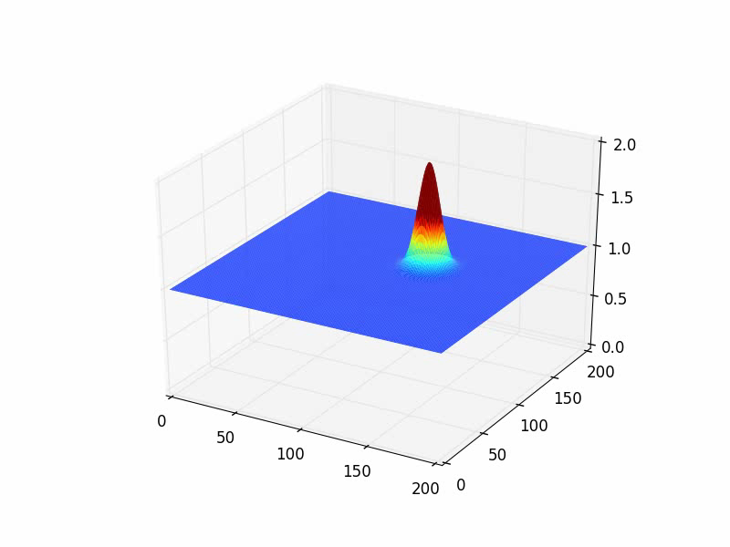
Modeling 1-D advection and other approximations

Slide 2
Outline of Class
Schedule:
Lecture １ Definition and types of PDE
Lecture 2 Modeling of flow phenomena with the hyperbolic PDE
Lecture 3 Analytical solution of the hyperbolic PDE (D’Alembert Solution)
Lecture 4 Analytical solution of the hyperbolic PDE (Fourier series)
Lecture 5 Modeling of diffusion phenomena with the parabolic PDE
Lecture 6 Analytical solution of the parabolic PDE
Lecture 7 Derivation and solution of elliptical equation Poisson
Lecture 8 Test level of understanding (Exercise Problems for Lecture 1-7)
Lecture 9 Introduction to Numerical analysis
Lesson 10・11 Numerical solution of PDE – Parabolic equation
Lesson 12・13 Numerical solution of PDE – Combined Parabolic/Hyperbolic
Lesson 14・15 Numerical solution of PDE – Hyperbolic equation
Term-end Report
Grading System
mid-term examination (45%), term-end report (45%), short exercises (10%)

Slide 3
Outline
Sub: What is the numpy.roll function? Let’s investigate together!
Main: Numerical Modeling of Advection equation
Finite Difference Method vs. Interpolation Methods

Slide 4
Why are there multiple approximations to PDEs?
To minimize errors (instability).
Measures of stability differ with phenomena.
Calculation speed.
Ease of implementation.

Slide 5
Understanding numpy’s roll function.

Slide 6
Basic FDM Methods
Approximation for the 1st order,
Forward Difference
Backward Difference
Central Difference
Approximation for the 2nd order,

Slide 7
Testing sample]
represented in discretized form
Given an array ,
Solve for using python by:
Iteration (for loop)
np.roll

Slide 8
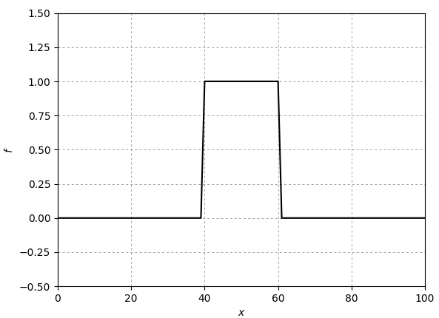
Mission for the week is to model the following:
1-D Advection
and a cyclic boundary.
Given initial conditions at time t=0,
With parameters,

Slide 9
Let’s try our skills to solve
FTCS (Forward in time, centralized in space)
If the lower the C the more accurate, let’s set it to 0.1

Slide 10
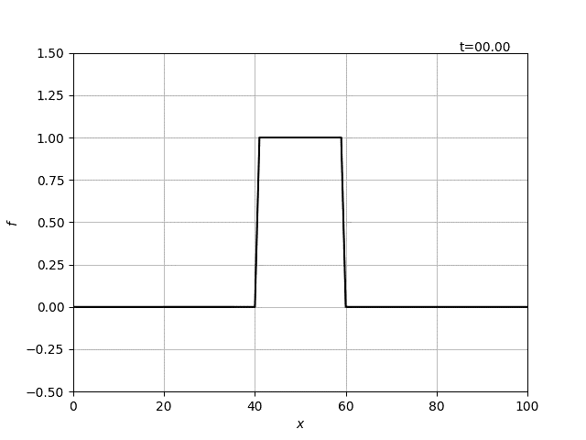
Ideally,

Slide 11
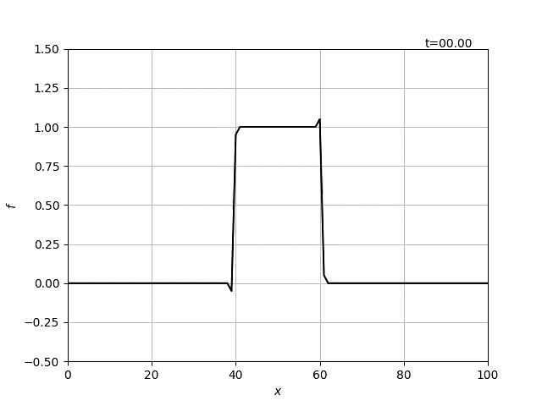
FTCS
Amplification error. Unconditionally Unstable.

Slide 12
FTCS??
Even if Centralized Differencing is of 2nd order, it causes large errors in the resulting solution.
The reason behind this is the forward differencing!
The advection solution generally relies on the flow upstream/upwind.
Recall that in Burger’s equation, we used backward differencing.
The combined influence of u, △x, and △t affects stability.

Slide 13
Let’s try another perspective.
Approach based on the characteristic of advection equation that
「flows come from the upstream at a flow velocity u」
1-D advection equation
(hyperbolic)
Analytical solution
node
Value at t_{n+1}
How can we obtain the advection value at the origin（ ） ？
Interpolation （Function）

Slide 14
Today’s Objectives
Interpolation Methods
Lagrange Interpolation
Linear Interpolation
Leith’s Method+Lax-Wendroff Method
Hermite Interpolation
Spline Method
Constrained Interpolation Method (CIP Method)

Slide 15
Lagrange Interpolation (1st Order Interpolation)

Slide 16
Lagrange Interpolation (1st Order Interpolation)

Slide 17
Lagrange Interpolation (1st Order Interpolation)
By using trigonometry and similar triangles:
First-order upwind difference method
Upstream needs to be defined by the direction of u:

Slide 18
Lagrange Interpolation (1st Order Interpolation)
First-order upwind difference method
If u>0,
Familiar?

Slide 19
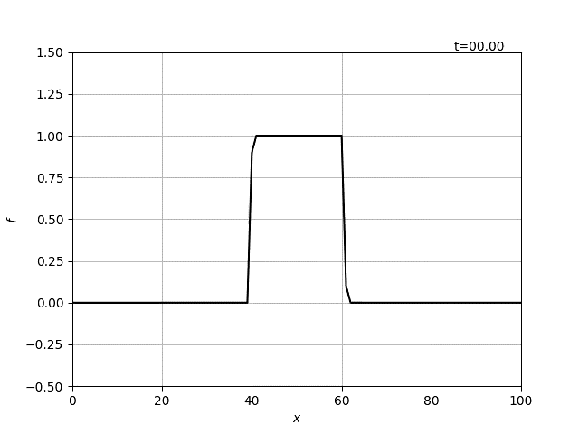
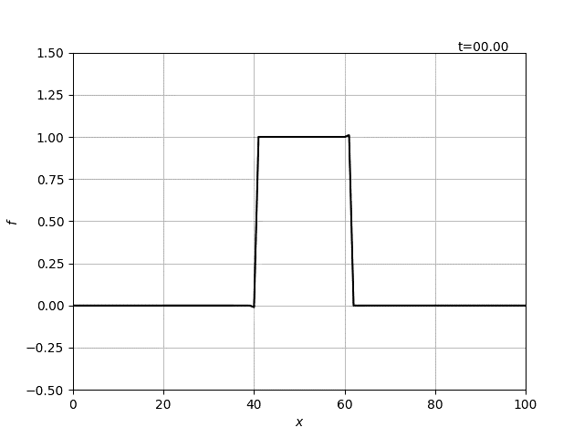
Lagrange Interpolation (1st Order Interpolation)
First-order upwind difference method (C=0.1 and C=1.01)
Rightwards animation mean increasing C
Dissipation Error
Gibb’s Error
Conditionally Stable.

Slide 20
Lagrange Interpolation (1st Order Interpolation)
Fist upwind difference when u<0：
Fitting into
：Courant Number

Slide 21
Lagrange Interpolation (1st Order Interpolation)
：Courant Number
Focus on the sign at the right-hand side,
IF
By definition, is a linear interpolation between an upstream and a downstream
thus the condition is satisfied when
：Stable condition

Slide 22
Physical meaning
Ratio of the distance traveled after a time Δt and the Δx.
Stability condition
Condition for the origin to exist between two end nodes (interior)
The origin is located outside.
Numerically unstable.

Slide 23
Courant-Friedrichs-Lewy Condition
Courant number
defines stability in advection.
：CFL(Courant-Friedrichs-Lewy) condition
In 2-Dimension,

Slide 24
Lagrange Interpolation (Leith’s or Lax-Wendroff Method)
A method to suppress the dissipation error was introduced by increasing the order of interpolation.
2nd order polynomial:
Determining unknown coefficients:
2nd Order Accuracy
Increases with increasing order of polynomial fitting.

Slide 25
Lagrange Interpolation
Increases as the order of polynomial increases, but
This means more nodes are needed.
More nodes mean more conditions need to be defined.
Hermite Interpolation was developed.
Another function aside from that of f is needed.

Slide 26
Hermite Interpolation (Cubic-Spline)
Derive interpolation function using a cubic polynomial.
Four unknown coefficients but only 3 nodes.
Any ideas where we can get another function?

Slide 27
Hermite Interpolation (Cubic-Spline)
A gradient can be defined:

Slide 28
Hermite Interpolation (Cubic-Spline)
Same procedure as in the Leith’s method focusing on the single element,
In addition, the derivative must satisfy g,
then,

Slide 29
Hermite Interpolation (Cubic-Spline)
Additional condition:
As the node spacing decreases, we expect the slopes transitions smoothly between nodes.
Where will these come from?

Slide 30
Hermite Interpolation (Cubic-Spline)
Additional condition:
As the node spacing decreases, we expect the slopes transitions smoothly between nodes.
2nd Order interpolation function at interval [x_{i},x_{i+1}]:
2nd Order interpolation function at interval[x_{i-1},x_{i}] ：
2nd order differential at x_{i} is continuous
Interval [x_{i},x_{i+1}]
Interval [x_{i-1},x_{i}]
Substituting
a conditional statement as follows can be obtained,

Slide 31
Hermite Interpolation (Cubic-Spline)
To solve for , simultaneous equations of the following must be conducted.
Large-scale matrix calculation is necessary!
0’s
0’s
But this is 3rd order accurate. ^_^

Slide 32
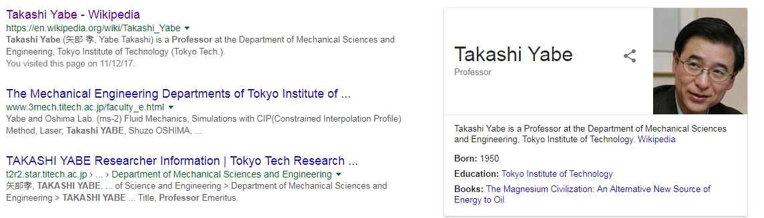
Hermite Interpolation (Cubic-Spline)
How can we simplify the calculation for ?
A professor from Tokyo Tech discovered a more efficient method called the
Constrained Interpolated Profile Method
By deriving an interpolation function for !!!

Slide 33
Hermite Interpolation (Constrained Interpolation Method)
The gradient is also advected!
If u is constant,

Slide 34
Hermite Interpolation (Constrained Interpolation Method)
Redraw
Recall.

Slide 35
Hermite Interpolation (Constrained Interpolation Method)
Slope at x_{p} is also estimated by interpolation

Slide 36
Hermite Interpolation (Constrained Interpolation Method)
1-D Advection by CIP:
If u is not constant.

Slide 37
Mission for the week
1-D Advection
and a cyclic boundary.
Given initial conditions at time t=0,
With parameters,
Model using (1) Upwind scheme, (2) Leith’s Method, and (3) CIP Method, (4) analytical solution. Use appropriate C required in the discussion.
Construct f plots along x for t=100, 300, 500, 700. Compare the results of each method and discuss the errors accompanied by each method.
Note: Make sure the source code is organized by adding comments “#”. Attach animation.

Slide 38
Textbook reference
Computational Fluid Dynamics by T.J. Chung
Downloadable via Tokyo Tech OPAC
Yabe, T., Xiao, F., Utsumu, T. The Constrained Interpolation Profile Method for Multiphase Analysis, Journal of Computational Physics, 169(2), 556–593 (2001).
Paper reference

